Slide 1

STUDENT PERFORMANCE PREDICTION SYSTEM
BATCH NO :
SUPERVISED BY
Dr.S.Alex David
PRESENTED BY
Sri Deekshitha Gumalla (VTU 28350)(23UEAM2008)
2. Eswar Venkat Kasturi (VTU 28351)(23UEAM2003)
DEPARTMENT ARTIFICIAL INTELLIGENCE & MACHINE LEARNING

Slide 2
Project Title
AGENDA
Introduction
Literature Survey
Problem Statement
Proposed Methodology
Proposed System Architecture
Implementation Plan/Timeline
Conclusion and Future Work
References
DEPARTMENT ARTIFICIAL INTELLIGENCE & MACHINE LEARNING

Slide 3
Introduction
Problem Statement:
Identifying weak students early
Improving academic results
Providing personalized support
Project Goal:
To develop a Machine Learning based system that predicts student
performance based on academic, behavioral, and demographic factors
.
Brief Overview:
Analyze student data
Predict final grades or pass/fail status
Help institutions take early intervention steps
DEPARTMENT ARTIFICIAL INTELLIGENCE & MACHINE LEARNING

Slide 4
Literature Survey
Existing Systems and Related Works:
Manual performance analysis by teachers
Percentage-based evaluation systems
Simple statistical analysis methods
Reasearch Insights:
Machine Learning improves prediction accuracy
Decision Trees & Random Forest give strong results
Early prediction reduces dropout rates
Feature selection improves model performance
DEPARTMENT ARTIFICIAL INTELLIGENCE & MACHINE LEARNING

Slide 5
Problem Statement
Problem:
Predicting student performance accurately
Identifying at-risk students early
Reducing dropout rates
Limitations of Existing Solutions:
Manual evaluation is time-consuming
No early warning system
Lack of data-driven decision making
DEPARTMENT ARTIFICIAL INTELLIGENCE & MACHINE LEARNING

Slide 6
Proposed Methodology
Steps Involved :
Data Collection
Data Preprocessing
Exploratory Data Analysis
Model Training
Model Evaluation
DEPARTMENT ARTIFICIAL INTELLIGENCE & MACHINE LEARNING

Slide 7
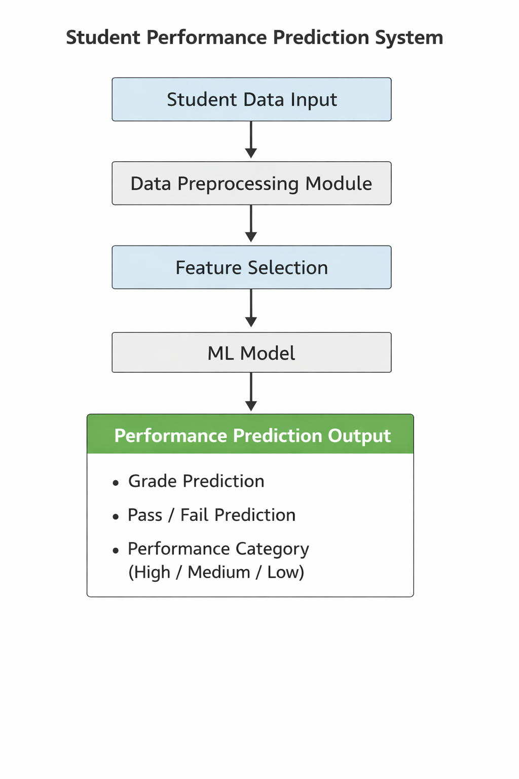
Proposed System Architecture
DEPARTMENT ARTIFICIAL INTELLIGENCE & MACHINE LEARNING

Slide 8
Summary of Module -1 & 2
Module-1:
Objective: To gather relevant and high-quality data for model development.
Collected student dataset
Cleaned missing values
Converted categorical features
Gathered demographic details such as age and background.
Module-2:
Objective:To clean and prepare the dataset for machine learning algorithms.
Handled missing values using mean/median/mode techniques
Analyzed attendance impact
Studied study hours vs marks
Visualized grade distribution
DEPARTMENT ARTIFICIAL INTELLIGENCE & MACHINE LEARNING

Slide 9
Summary of Modules -3 & 4
Module-3:
Objective: To build a predictive model for student performance.
Split dataset into training and testing sets (e.g., 80%-20%).
Applied multiple Machine Learning algorithms.
Trained models using training data.
Compared model performance using accuracy scores.
Module-4:
Objective:To validate the effectiveness of the prediction system.
Tested model using unseen test data.
Generated Confusion Matrix for classification results
Reduced overfitting and improved generalization.
Analyzed prediction errors and misclassification cases.
DEPARTMENT ARTIFICIAL INTELLIGENCE & MACHINE LEARNING

Slide 10
Software & Hardware Requirements Specification
Software:
Python
Jupyter Notebook
NumPy
Pandas
Seasborn
Matplotlib
Hardware:
Minimum 8GB RAM
Intel i5 or above
20GB free storage
DEPARTMENT ARTIFICIAL INTELLIGENCE & MACHINE LEARNING

Slide 11
Implementation Plan/Timeline
Week 1-2:
Dataset Collection
Problem Definition & Literature Survey
Week 3-4:
Data Preprocessing
Exploratory Data Analysis
Week 5-6:
Model Building
Model Optimization
Week 7-8:
Model Evaluation
Documentation & Presentation
DEPARTMENT ARTIFICIAL INTELLIGENCE & MACHINE LEARNING

Slide 12
Conclusion and Future Work
Conclusion:
AI-based student prediction improves academic monitoring
Helps identify weak students early
Supports data-driven decisions
Reduces dropout rates
Improves overall academic performance
Future Work:
Deploy as Web Application
Add Real-time prediction system
Integrate with College ERP
Add Student Performance Dashboard
DEPARTMENT ARTIFICIAL INTELLIGENCE & MACHINE LEARNING

Slide 13
References
Educational Data Mining Techniques
Scikit-learn Documentation
Research papers on Student Performance Prediction
Kaggle Student Dataset
Educational Data Mining Research Articles
NumPy Documentation
Academic Risk Prediction Models
Educational Data Mining Techniques
DEPARTMENT ARTIFICIAL INTELLIGENCE & MACHINE LEARNING

Slide 14
THANK YOU
DEPARTMENT ARTIFICIAL INTELLIGENCE & MACHINE LEARNING

